Slide 1
Freelancer Tracker
31/07/2025
Command-line tool for managing freelancers

Slide 2

Introduction
This project, titled Freelancer Tracker, is a Python-based command-line application backed by an SQLite database. It is designed to help users efficiently manage, track, and book freelancers through a simple text-based interface.
The primary objective is to simplify freelancer management by allowing users to:
Add and store freelancer details
Filter based on skills and availability
Book freelancers and update their status

Slide 3
Project Overview
Goal: Track, manage, and book freelancers using terminal
Features:
Add freelancers
Filter/search by skill
Book or mark available
Tech Stack:
Python (sqlite3 module)
SQLite (freelancers.db)

Slide 4
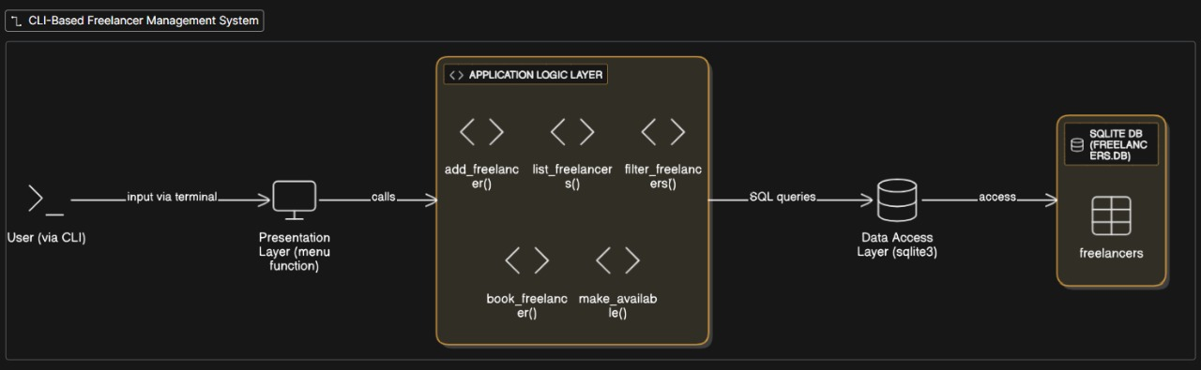
Architecture and Database

Slide 5
Database Structure
Column Name | DataType | Description
id | INTEGER | Primary Key, auto-incremented
name | VARCHAR | Freelancer’s name
skills | VARCHAR | Comma separated skill list
is_available | INTEGER | 1=available 0=Booked

Slide 6

Main Functions and Relationships
add_freelancer(name, skills)
list_freelancers()
filter_freelancers(skill, available_only)
book_freelancer(freelancer_id)
make_available(freelancer_id)

Slide 7
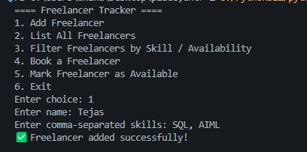
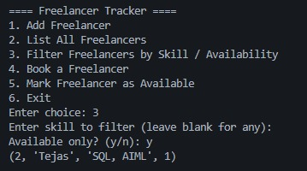
Demo
Add Freelancer
Filter Freelancer

Slide 8
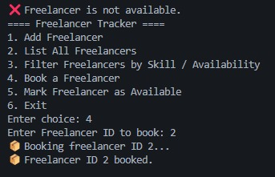
Demo
Book Freelancer

Slide 9
THANK YOU!

